Slide 1
Chapter 10
Chapter 10 Telecommunications Management Network
Week 7
Telecommunications Management Network
TMN
Chapter 10 takes network management to a higher-level management, TMN, based on the OSI model.
It addresses five levels of management :
    network element layer,
    element management,
    network management,
    service management, and
    business management.

Slide 2
Objectives
Telecommunications Management Network, TMN
Concept of Operations Support System, OSS
TMN conceptual model includes:
  Customers
  Service providers
  Network
  Operations support systems, OSSs
  System operators
TMN standards and documentation (ملغي)
TMN architecture
  Functional
  Physical
  Informational
TMN service management architecture
  Network element
  Element management
  Network management
  Service management
  Business management
TMN service management
  Operations, Administration, Maintenance, Provisioning; OAMP
TMN implementation methodologies
  OMNIPoint
  eTOM

Slide 3
In this chapter, we will discuss the management of telecommunication networks and services provided by these public and private utility companies, and service providers.
The standards for management of the telecommunication network it is strongly based on ISO network management, which in turn is based on Common Management Information Protocol (CMIP) and Common Management Information Services (CMIS). Although this chapter addresses telecommunications network management without the requirement of CMIP/CMIS-based management.
In 1986, the International Telecommunications Union—Telecommunications (ITU-T) proposed the concept of Telecommunications Management Network (TMN) to address interoperability of multivendor equipment used by service providers and to define standard interfaces between the service provider operations.
In addition, it also extended the concept of management to include not only management of networks and network elements, but also service functions of service providers. It was envisioned as a solution to the complex problems of operation, administration, maintenance, and provisioning (OAMP) for the telecommunication networks and services.
Interoperability قابلة للتشغيل المتبادل.

Slide 4
Chapter 10 Telecommunications Management Network
TMN
Necessity for interoperability basis for TMN
Need for management of more than just the network components
Networks / subnetworks need to be managed
Services - internal and external need management
Business management needs to be addressed
TMN joint effort by ITU-T and ISO
  Notes

Slide 5
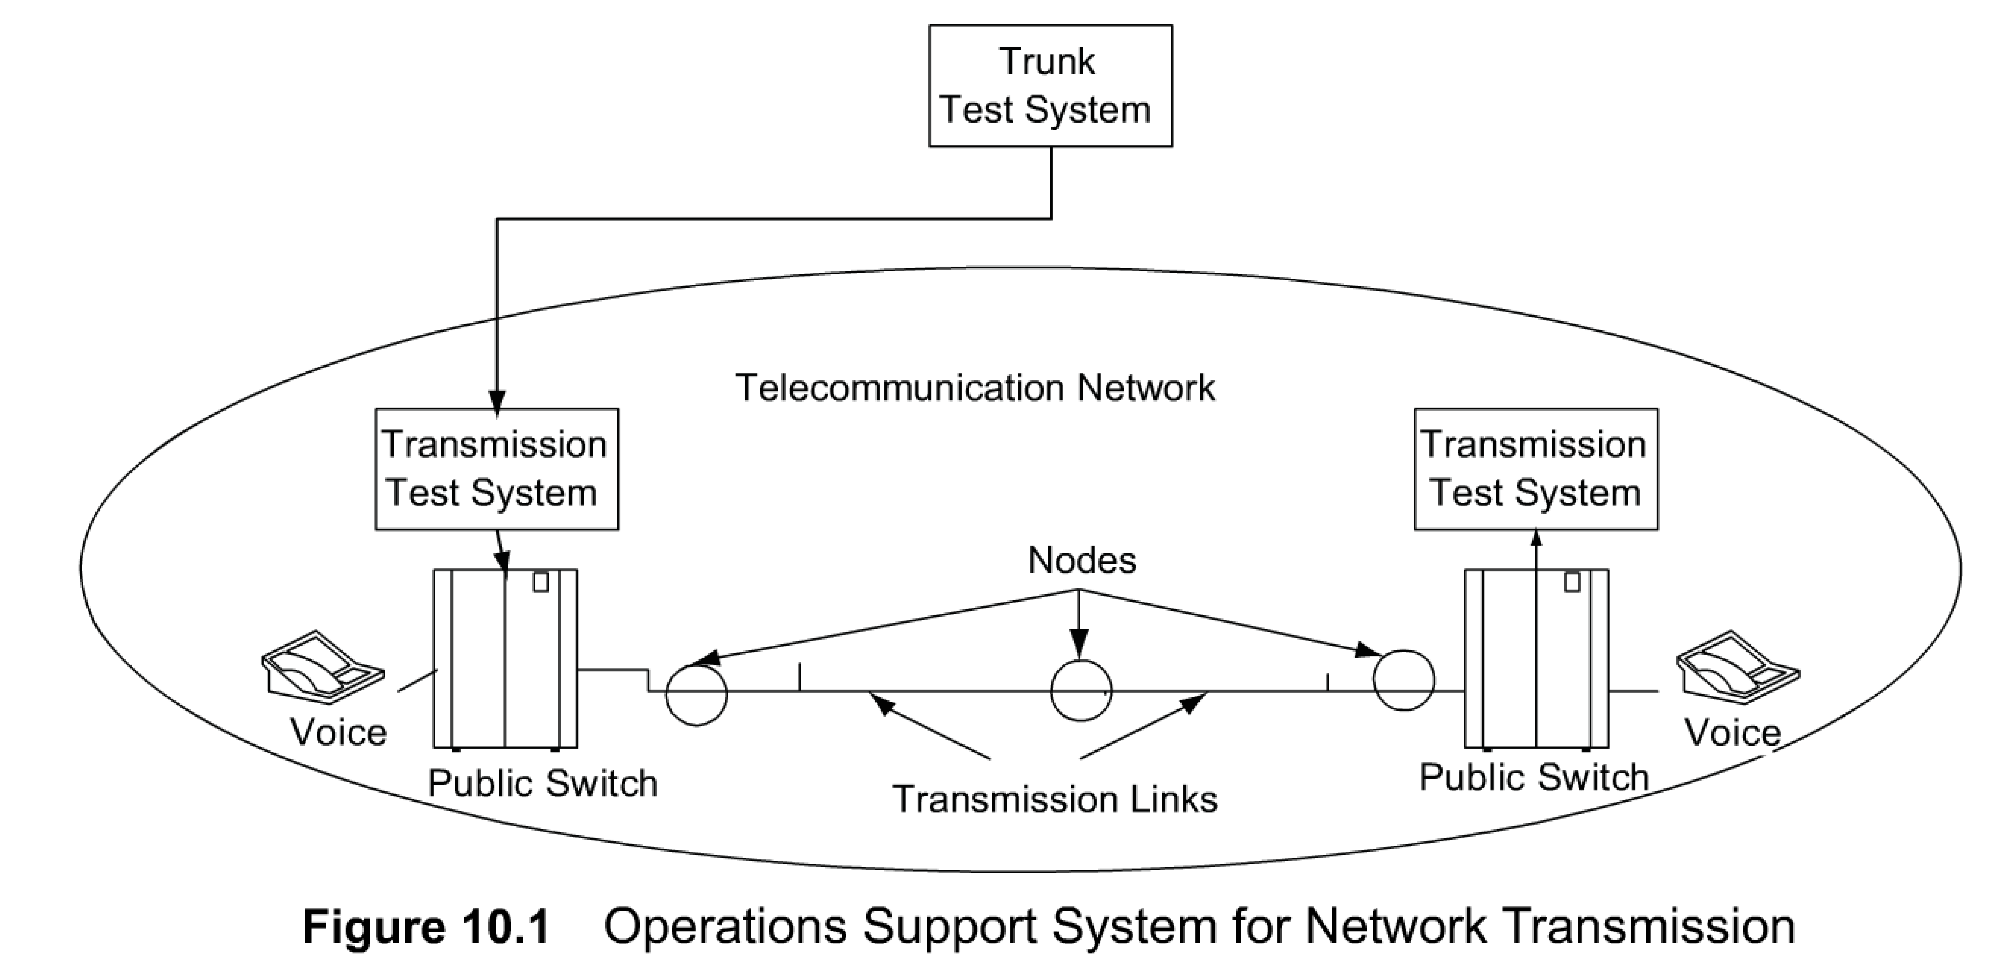
Chapter 10 Telecommunications Management Network
OS: Trunk Testing System
The trunk test system shown in Figure 10.1 is used to monitor the loss and signal-to-noise ratio in the trunk transmission system in Bell System.
A trunk is a logical entity linking two switching offices.
It can seize any available cable facility between the switches while carrying traffic. In order to ensure quality of service, loss and signal-to-noise on the trunks are measured at regular intervals by accessing every trunk at each switching office. This is done from a centralized test center.
Any trunk that fails to meet the minimum criteria set for quality control is removed from service. Thus, by removing a trunk out of service as it is failing (but before it actually fails), the customer does not see any degradation of service. The same test system is also used for an on-demand test to track troubles.
Except during popular holidays such as Mother's Day, telephone service is almost always available for communication at any time of the day. This is due to careful planning and implementation of adequate facilities for traffic to be handled without being blocked for lack of facilities.
  Notes
Trunk is a logical connection between two switching nodes
Periodic measurement of loss and S/N of all trunks
Failing threshold set for QoS; failing trunks removed out of service before the customer complains
TMN is built using the building blocks of the operations support system.
Figure 10.1 and Figure 10.2 present two examples of operations systems that are used in the operation of telephone network and services: trunk test system and traffic measurement system.

Slide 6
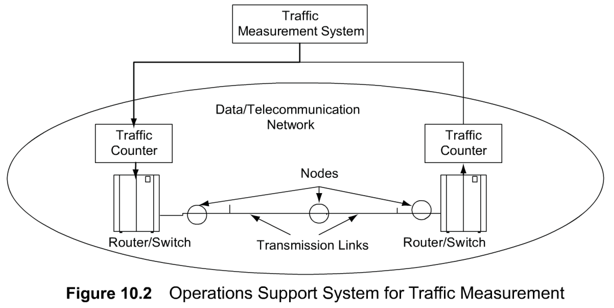
Chapter 10 Telecommunications Management Network
OS: Telephone Switch Traffic
Figure 1 0.2 shows a traffic measurement operations system, which measures the busy status of switch appearance (access point) on each switch.
As the statistics on the number of paths being busy increases, either due to the lack of access points or the lack of adequate trunk facilities, additional equipment is added to reduce blocking.
  Notes
Traffic monitored at switch appearance
Call-blocking statistics obtained
Traffic and call-blocking statistics provide data for planning
Importance of Operations, Administration, Maintenance, and Provisioning

Slide 7
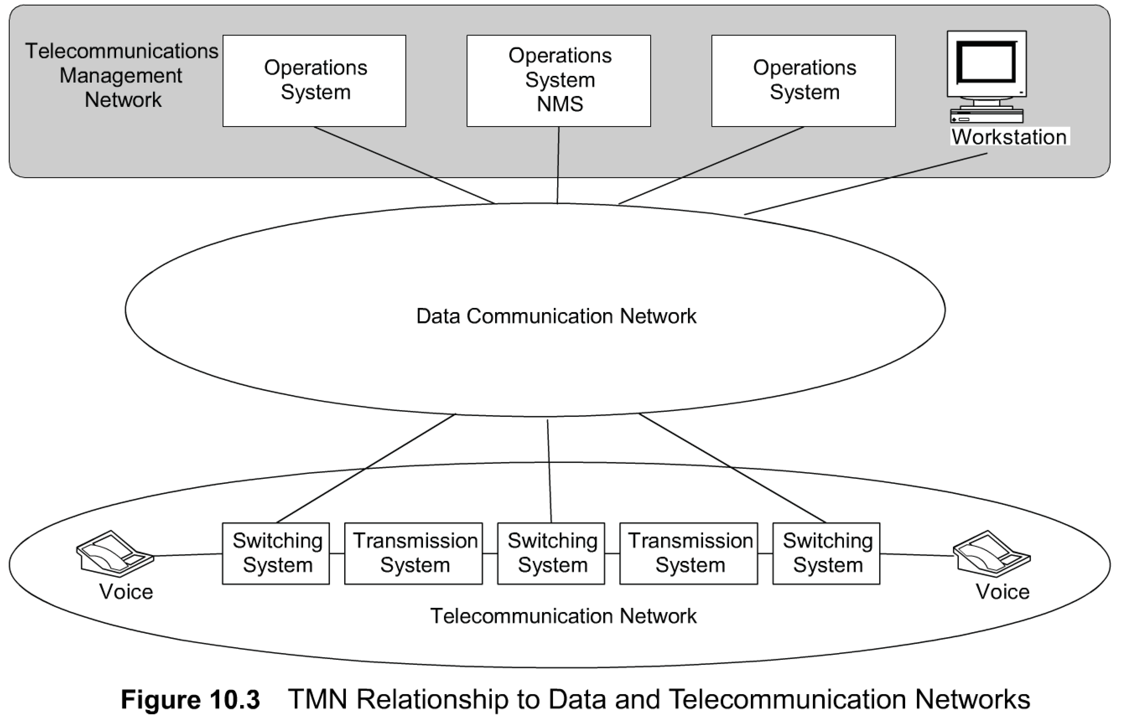
Chapter 10 Telecommunications Management Network
TMN Conceptual Model
the network management system is treated as an operations support system, as shown in Figure 10.3. It manages the data communication and telecommunication network.
The telecommunication network in Figure 10.3 consists of network elements of switching exchanges and transmission systems. It is primarily the wide area network of communications. Switching systems include both analog and digital switches. And so are the transmission systems of both analog and digital types and include all means of
transport facilities including twisted pair, coaxial, fiber optics, and wireless.
Data communication network components consist of LANs, bridges, routers, gateways, and hosts. The workstation shown in Figure 10.3 that is attached to the data communication network is a distinct element of TMN, whose interface we will discuss later.
Figure 10.3 is TMN as a conceptually separate network that interfaces to one or more individual telecommunication networks at several points in order to send or receive information to or from them and control their operation. It consists of a network of operations systems including a network management system, which, as we stated earlier, is also considered an operations system.
  Notes

Slide 8
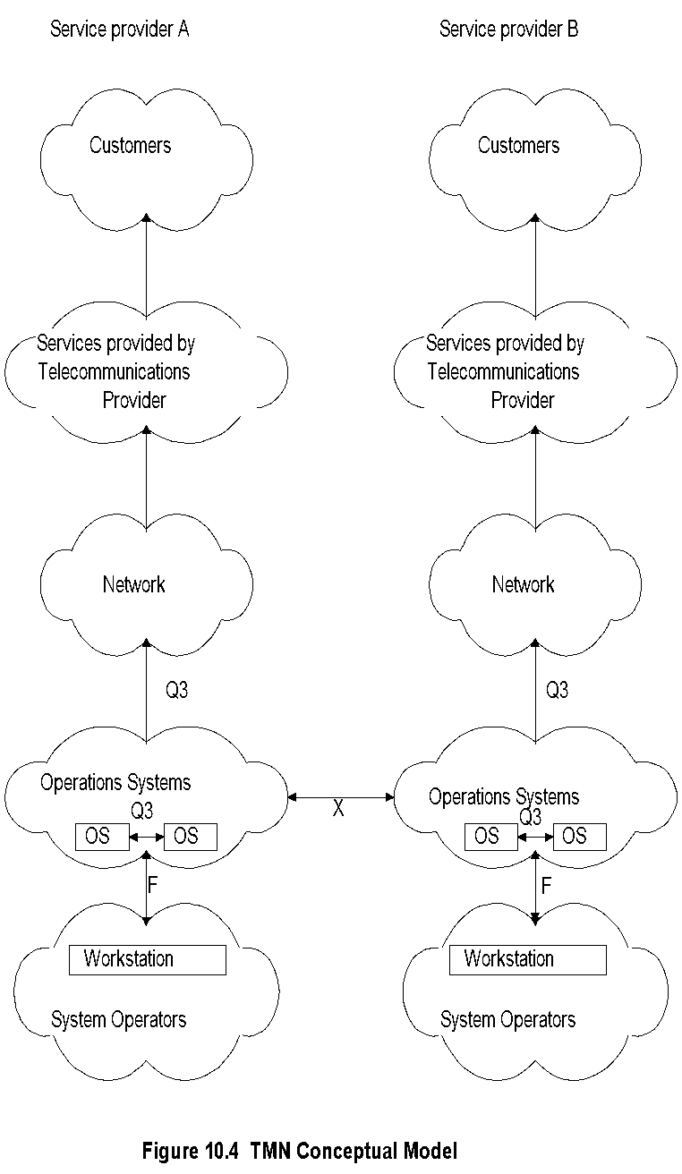
Chapter 10 Telecommunications Management Network
Figure 10.4 shows the TMN conceptual model. Notice that in this model not only are the networks and operations system depicted, but also services and human resources are brought in.
The two columns in the figure depict the identical components of the two service providers, A and B.
We identify the following components in Figure 10.4: workstations, operations systems, network, services, and interfaces.
Of course, there are the operators who operate on the systems and the customers who use the services.
Thus, service management is an important consideration in conceptualizing the TMN model.
The service provided by the service provider to the customer is telecommunication service, which means that the telecommunication network needs to be operated efficiently and economically.
The OAMP on the network needs to be handled in as much of an automated mode as possible to increase the response time and to decrease the cost.
Cost considerations lead to business management, which is addressed by the TMN model.
Service management, business management, and network management are all accomplished either partially or totally using the operations systems shown in Figure 10.4.
System operators interface with the operations systems using workstations.
The interfaces associated with various functions and services have been standardized in the TMN model. Notice the three interfaces—Q3, F, and X. Q3 is the interface between the operations system and the network element. F is the interface between the workstation and the operations system. Information exchange between operations systems within a TMN is accomplished using the Q3 interface, whereas operations systems belonging to different TMNs communicate over the X interface. We will discuss interfaces in more detail in Section 1 0.5.
TMN Conceptual Model (cont.)
  Notes
Components
Interfaces

Slide 9
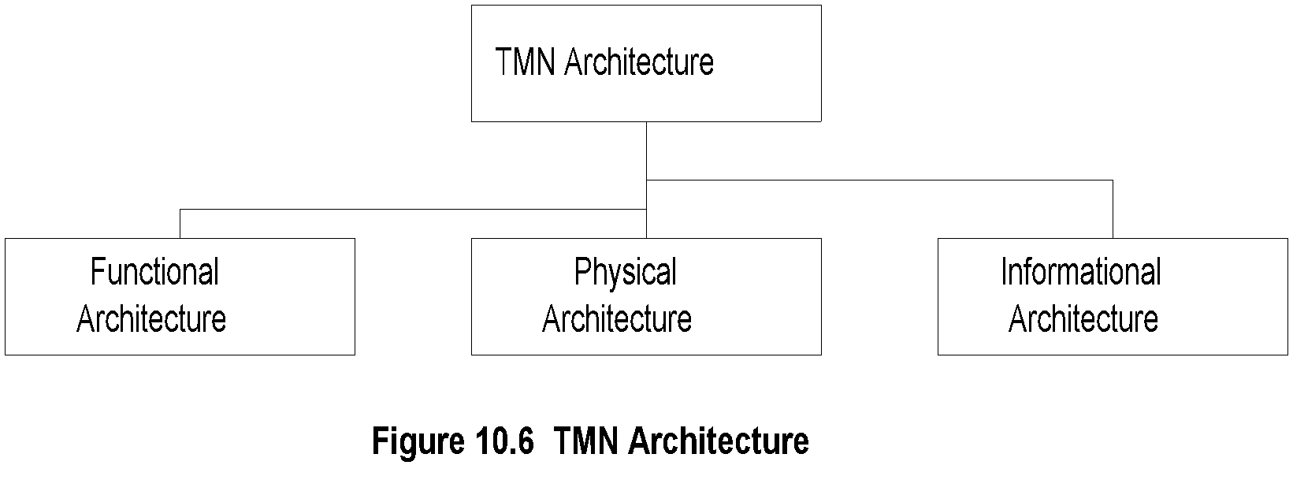
Chapter 10 Telecommunications Management Network
TMN Architecture
TMN architecture is defined in M.3010.
There are three architectural perspectives: functional, physical, and information, as shown in Figure 10.6.
The functional architecture identifies functional modules or blocks in the TMN environment, including the reference point between them. The requirements for interface are specified.
The physical architecture defines the physical blocks and interfaces between them.
Information architecture deals with the information exchange between managed objects and management systems, using a distributed object-oriented approach.
  Notes
Functional architecture:
  Functional modules or blocks
  Reference points between modules
Physical architecture:
  Physical blocks
  Physical interfaces between the blocks
Informational architecture:
  Information exchange between entities
  Object oriented

Slide 10
Functional Architecture
M.3010 defines TMN architecture made up of five function blocks: operations systems function (OSF) , network element function (NEF), mediation function (MF), workstation function (WSF), and Q-adapter function (QAF), as shown in Figure 10.7.
The communication between the function blocks itself is a function, but not a function block, defined as the TMN data communication function (DCF).
1. The TMN operations systems function (OSF) is implemented in operations systems. such as network transmission OS and traffic measurement OS help monitor, manage, and control telecommunication networks and services. Network management, both as a manager and an agent, is also considered to be an OS. This would include MIB in Internet management and naming tree in OSI management as a function of the OSF.
2. The TMN NEF is concerned with the managed network elements. Network elements themselves are not part of TMN, but are supported by TMN over the standard interfaces. Network elements would include hardware, software, and systems such as hubs, routers, switches, processes, etc. The network management agent and the associated MIB are part of the NEF. Network elements providing information for management, such as packets dropped, collision rate, etc., are considered as part of TMN, i.e., NEF.
3. The TMN MF block addresses the operations performed on the information content passing between the network elements and operations systems. Such operations include filtering, store and forward, protocol conversion, threshold detection, etc. A physical entity in which the MF is implemented can be shared between multiple operations systems and network elements. For example, a remote monitoring device (RMON) can monitor a remote LAN on various parameters such as statistics on users, protocols, and packet loss and report the analyzed data or raw data to accounting and performance management operations systems. In this situation, the RMON device acts as a mediation device performing MF between the network elements on the remote LAN and the operations systems (or network management systems).
4. The TMN WSF provides an interface between human personnel and TMN activities. More specifically, this function addresses the presentation aspect. The conversion function that converts machine-readable information to human-interpretable format in the presentation function belongs in one of the other three function blocks, OSF, MF, and QAF (explained later). This would cover the presentation function such as graphical user interface (GUI) and human-machine interface of workstations. Communication between the above four functional blocks, OSF, WSF, MF, and NEF, is assumed to be standardized. Of course, this is far from the reality of the world.
5. Therefore, in order to accommodate the legacy functionality as part of TMN, a TMN QAF has been defined. This is somewhat similar to a proxy server in SNMP management, where non-SNMP network elements are managed by an SNMP manager via a proxy server. Thus, TMN noncompliant devices are connected to a TMN-compliant system/network using a Q-adapter interface.

Slide 11
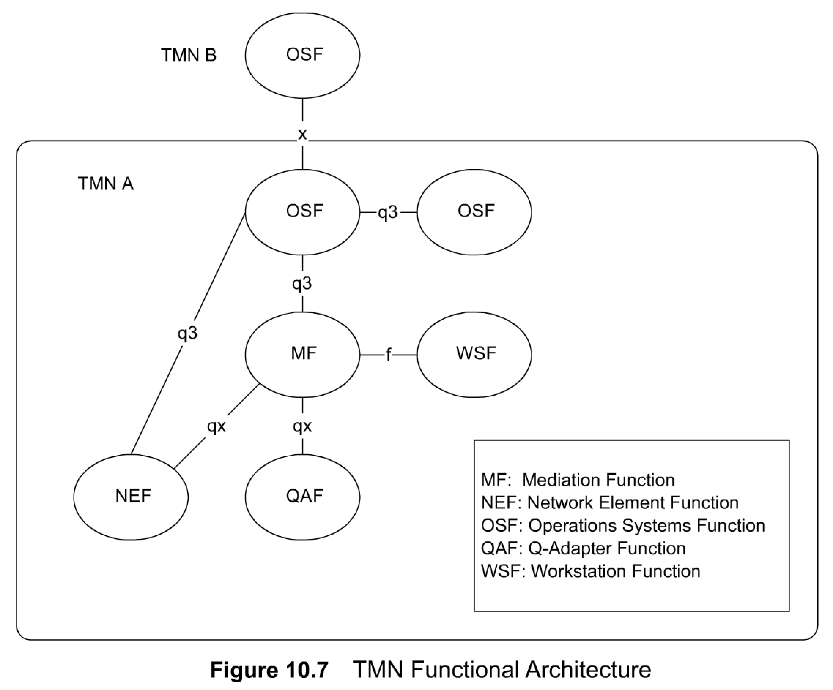
Functional Architecture
  Notes
OSF: Functions performed by Operations systems: e.g., NMS, testing, accounting, trouble tracking
NEF: Functions needed to support network elements; network elements themselves are not part of TMN: e.g., NM agent, MIB, collision rate
MF: Operations on the information between network elements; e.g., filtering, protocol conversion
MF can be shared between multiple OSSs; e.g., RMON
WSF: Human-TMN activities interface; e.g., GUI
QAF: Adapter function to accommodate non-TMN entities; e.g., proxy server, SNMP-to-CMIP

Slide 12
Functional Architecture Cont.
Each function providing a service and the service block providing a set of services.
An example would be a security management application function as either part of or a stand-alone operations system. such as alarm reporting, audit trail, etc. associated with the security functional area.
In fact, all five management functional areas of configuration, fault, performance, security, and accounting residing in a network management system would belong to OSF.
Function blocks are designed to be nonoverlapping.
Notice that the function blocks in Figure 10.7 are connected with interfaces designated by x, q3, qx, and f. These are called TMN service interfaces or simply, TMN interfaces.
The TMN interface between function blocks, shown in Figure 10.8, is called a TMN reference point.
A reference point can be considered to be a conceptual point of information exchange between function blocks.
An interface between a management agent embedded in a network element and a network management system will be a q3 reference point. When a network management system automatically creates a trouble ticket in a trouble tracking system, it is communicating via an x-reference point. When a Web browser interfaces with a Web-based management system, it is accessing an f-reference point. When a TMN-noncompliant switch is managed by a TMN-compliant operations system using a Q-adapter interface, it is interfacing via a qx interface.
The information exchange going across the TMN reference points can be classified into three classes: q-class, f-class, and x-class.
The q-class reference point interfaces to the management application function. In Figure 10.7, the q-class reference point includes both q3- and qx-class TMN reference points.
An f-class TMN reference point is an interface between the WSF block and any other function block in TMN.
An x-class TMN reference point is an interface between two operations system function (OSF) blocks belonging to two different TMNs, as shown in Figure 10.7. The interface information pertains to functionality of similar nature.
TMN reference points are designated by lowercase letters, q, f, and x, while the associated interfaces in the physical embodiment are identified using uppercase letters, Q, F, and X, as we shall see in the next section.

Slide 13
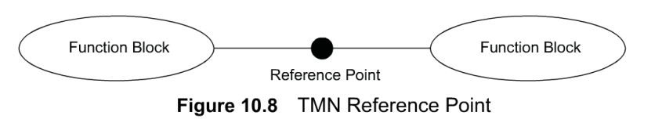
Chapter 10 Telecommunications Management Network
TMN Reference Point
  Notes
Function blocks connected by conceptual interfaces, called reference point
Designated by lower case letters (upper case letter for physical interfaces)
      x: Interface between operations systems that belong to different domains; e.g., interface between two NMSs belonging to two different domains
      q3: Interface between two OSFs in the same domain
      qx: Interface between mediation function such as RMON and agent in the network element
      f: Interface to the workstation

Slide 14
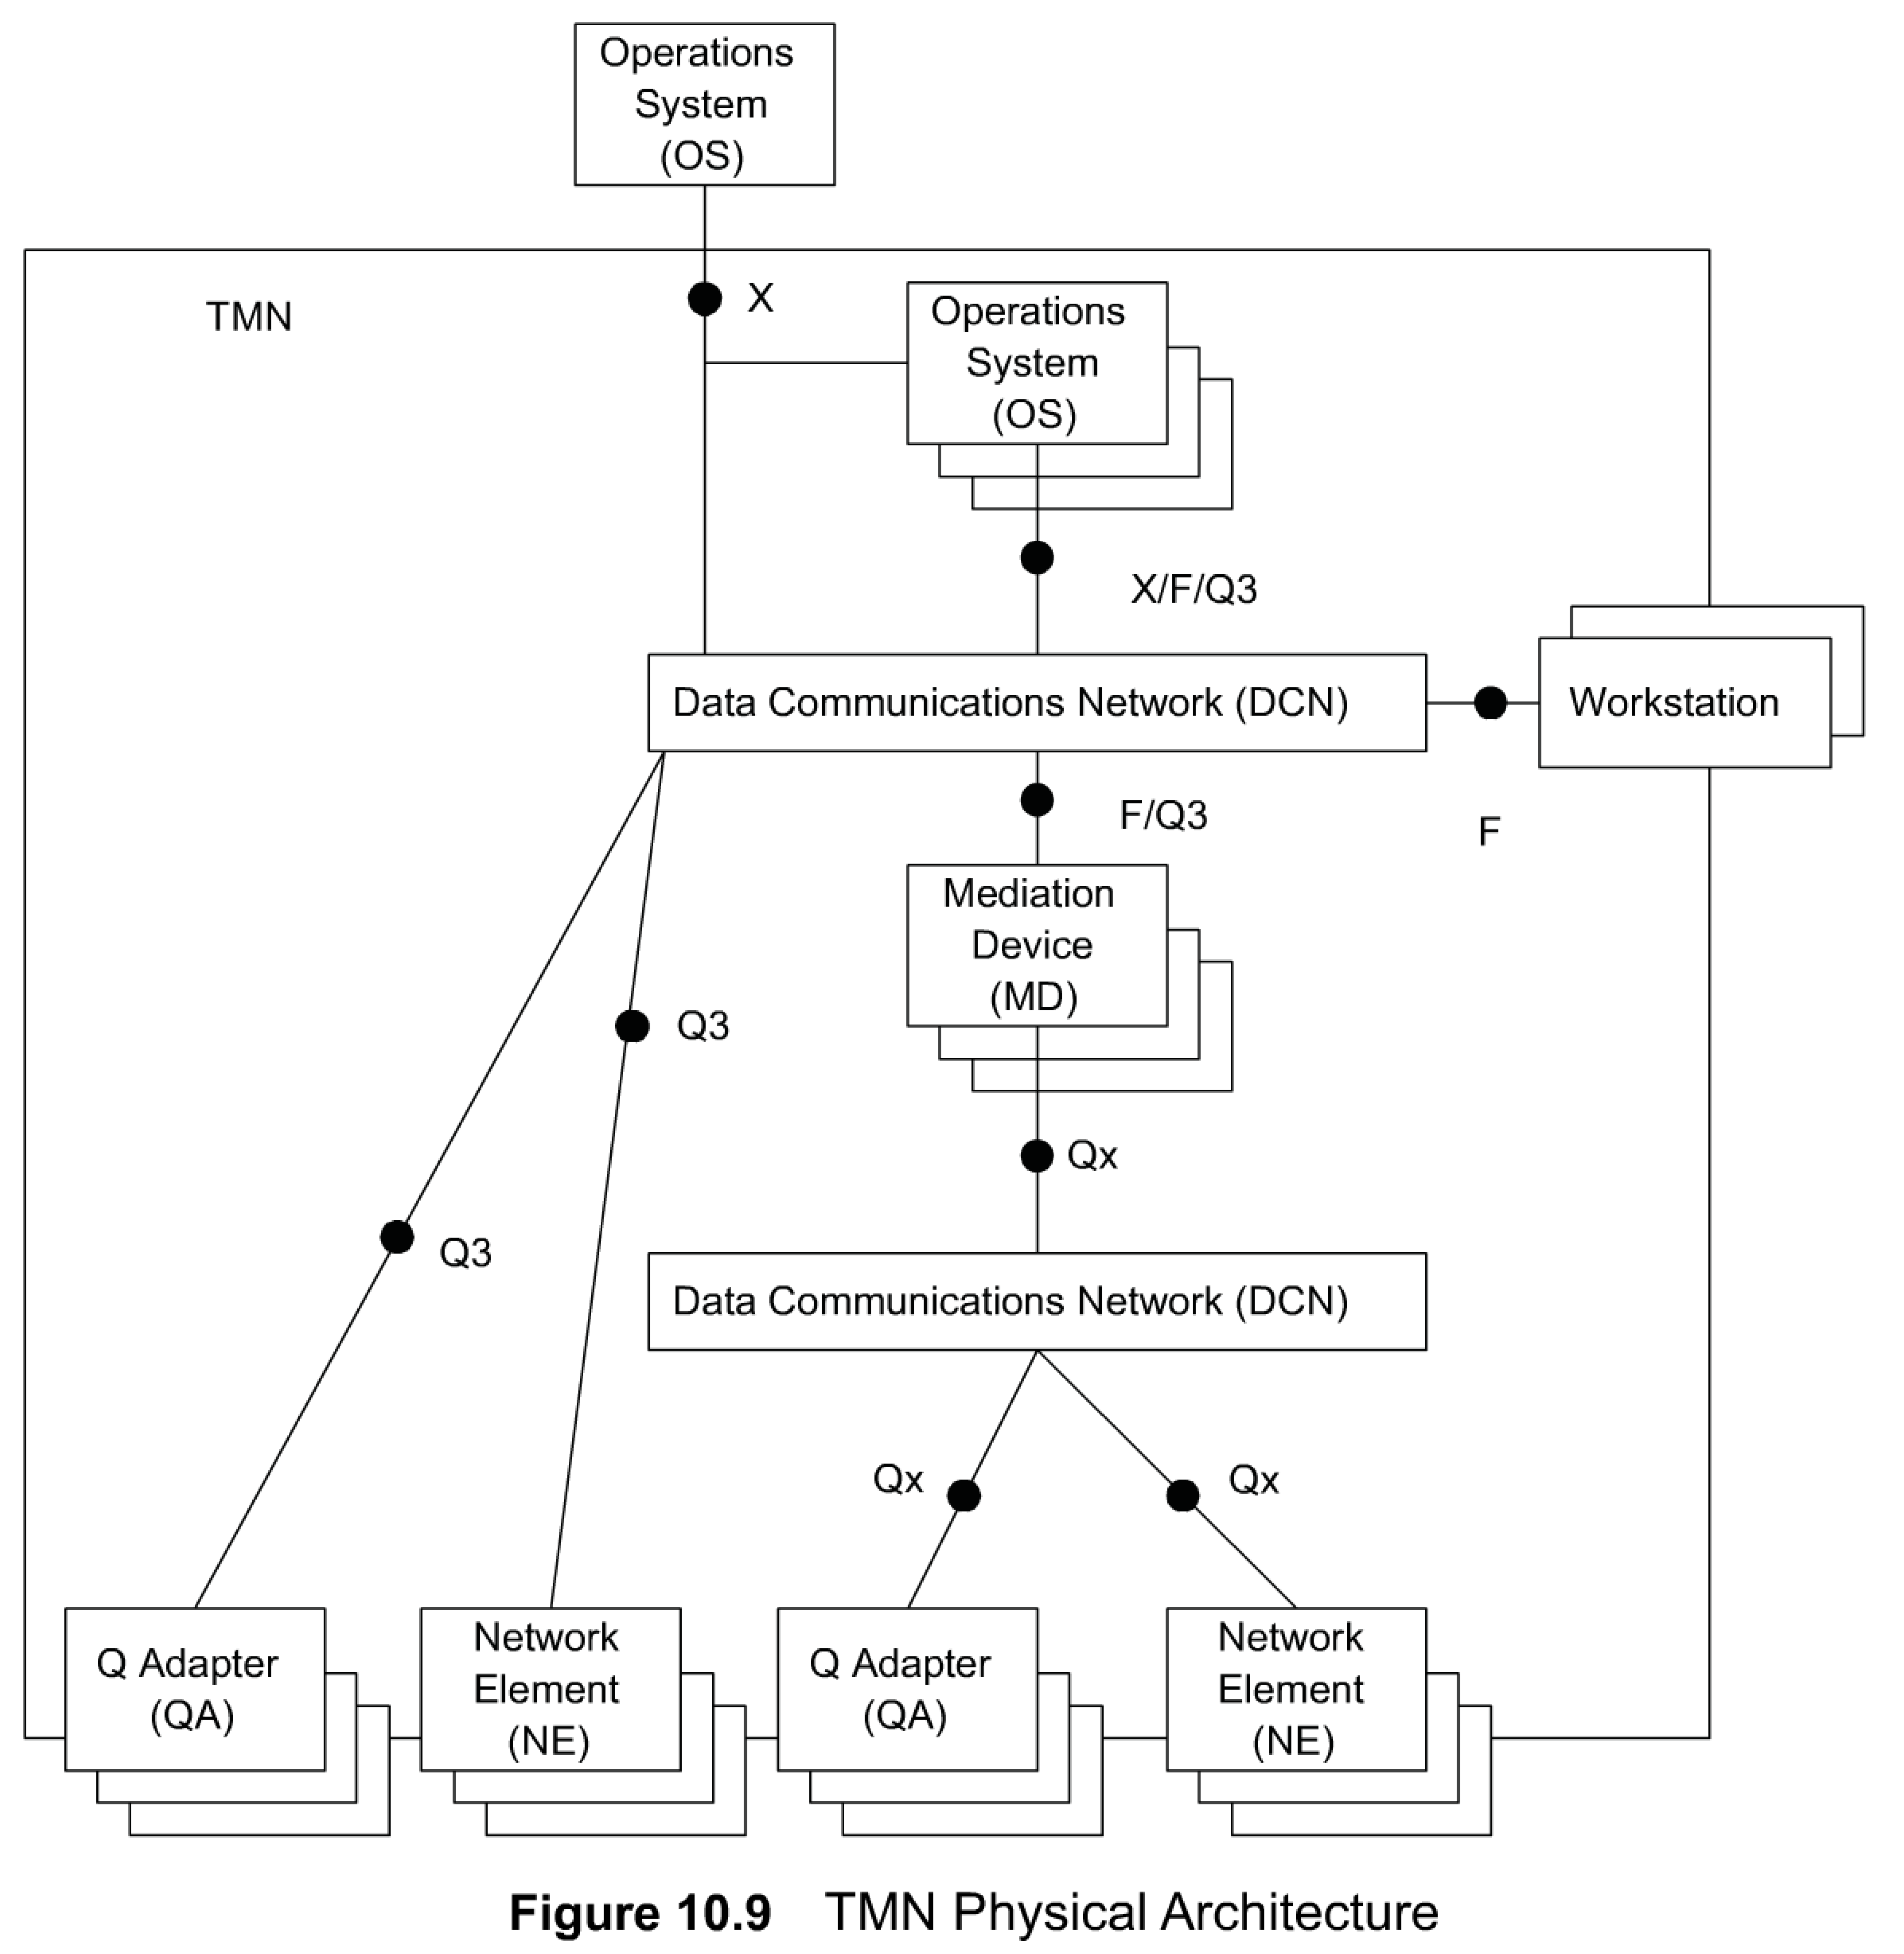
Chapter 10 Telecommunications Management Network
Physical Architecture
A TMN physical block could be an embodiment of one or more blocks, besides its equivalent function block. For example, an operations system could have its operation function as well as mediation device, which does filtering of information.
There are five types of physical blocks representing the five functions discussed in the previous section, excluding the TMN DCF.
Operations systems are embodiments of TMN OSF. It is connected to the mediation device, placing the MF on a data communication network. The data communication network is the physical implementation of DCF, which to repeat, is not a function block, but a TMN function, DCF. The network elements, Q adapter, and workstations reflect their respective TMN functions.
The 0, F, and X TMN interfaces between the physical devices are also shown in Figure 10.9, representing the physical implementation of the respective TMN reference points.
The Q3 interface is used between the OS and either an NE or a QA.
The Qx interface is shown between MD and QA/NE. An example of this would be an MD being a proxy server communicating with legacy systems via the QA interface.
The F interface is implemented to connect a workstation to TMN.
The X interface is between the operations systems belonging to two different TMNs.
  Notes
embodiment تضمين

Slide 15
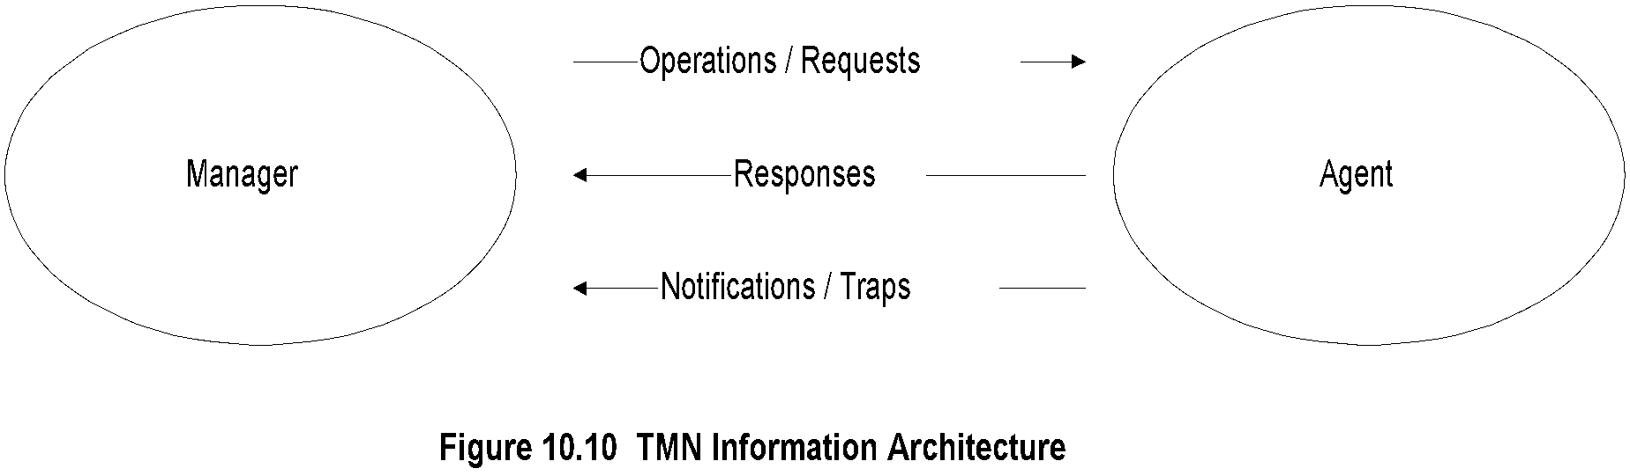
Chapter 10 Telecommunications Management Network
Information Architecture
  Notes
The TMN information architecture initially adopted the OSI management information architecture,
We have covered both management models in this book. The OSI information model is object oriented and the SNMP model is scalar. Both models are based on the dual roles that entities play in information exchange: manager and agent.
Figure 10. 1 0 shows the information exchange between the two types of entities. The manager performs operations or makes requests from an agent. The agent executes the operations on the network elements that it is managing and sends responses to the manager. The agent also sends unsolicited messages to the manager indicating alarm events. Information models specified by SNMP and OSI management deal with the management of network elements.
There are two types of communication services between interfaces: interactive and file oriented.
the interactive service is supported in OSI by CMISE over Remote Operations Service Element (ROSE). In the Internet distributed computing environment (DCE), this will be handled by Remote Procedure Call (RPC).
The file-oriented category is supported by File Transfer Access Management (FTAM) in OSI and in the Internet by File Transfer Protocol (FTP).

Slide 16
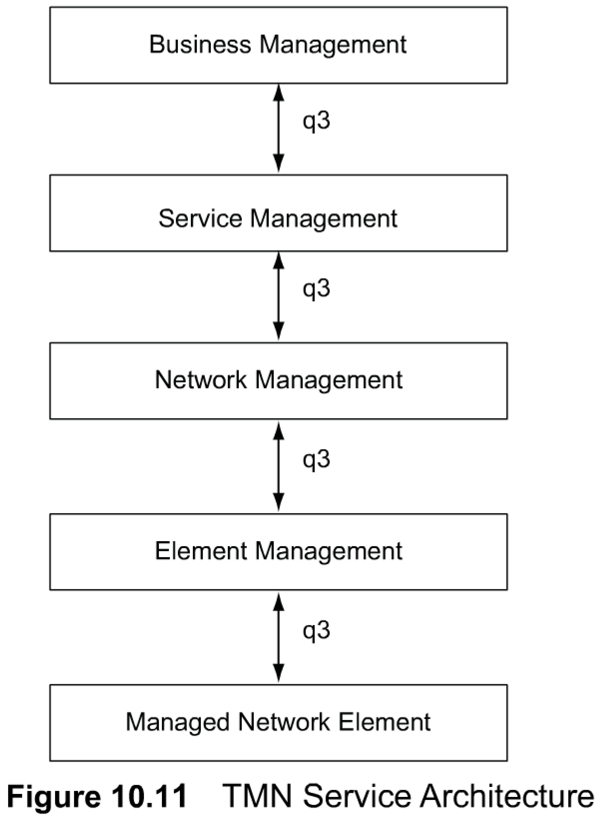
Chapter 10 Telecommunications Management Network
TMN MANAGEMENT
Service Architecture
Another functional model of TMN is based on the services provided in a TMN environment. The TMN services are grouped and presented as TMN layered architecture, as shown in Figure 10.11
The lowest layer is the network element layer comprising network elements such as switches, routers, bridges, transmission facilities, etc. The next layer, the network element management layer, manages the network elements. The third layer is the network management layer, which manages the network. The network management functions in this layer would include bandwidth, performance, quality of service, end-to-end flow control, network congestion control, etc.
The service management layer is concerned with managing the services provided by a network service provider to the customer or to another network service provider. This will include services such as billing, order processing, complaints, trouble ticket handling, etc.
The top layer is the business management layer. This is concerned with managing a communications business, such as fiscal considerations, personnel needs, project management, and customer needs and satisfaction.
We notice that the TMN reference point between the various service layers is q3, which is the standard interface between operations system, network element, and MFs shown in Figure 10.7.
The TMN management services are classified into OSI system management functional areas, which are the five OSI application functions described in Section 3.9. They are configuration management, fault management, performance management, security management, and accounting management. This is presented in Figure 10. 1 2.
  Notes
An interface between a management agent embedded in a network element and a network management system will be a q3 reference point.
      q3: Interface between two OSFs in the same domain

Slide 17
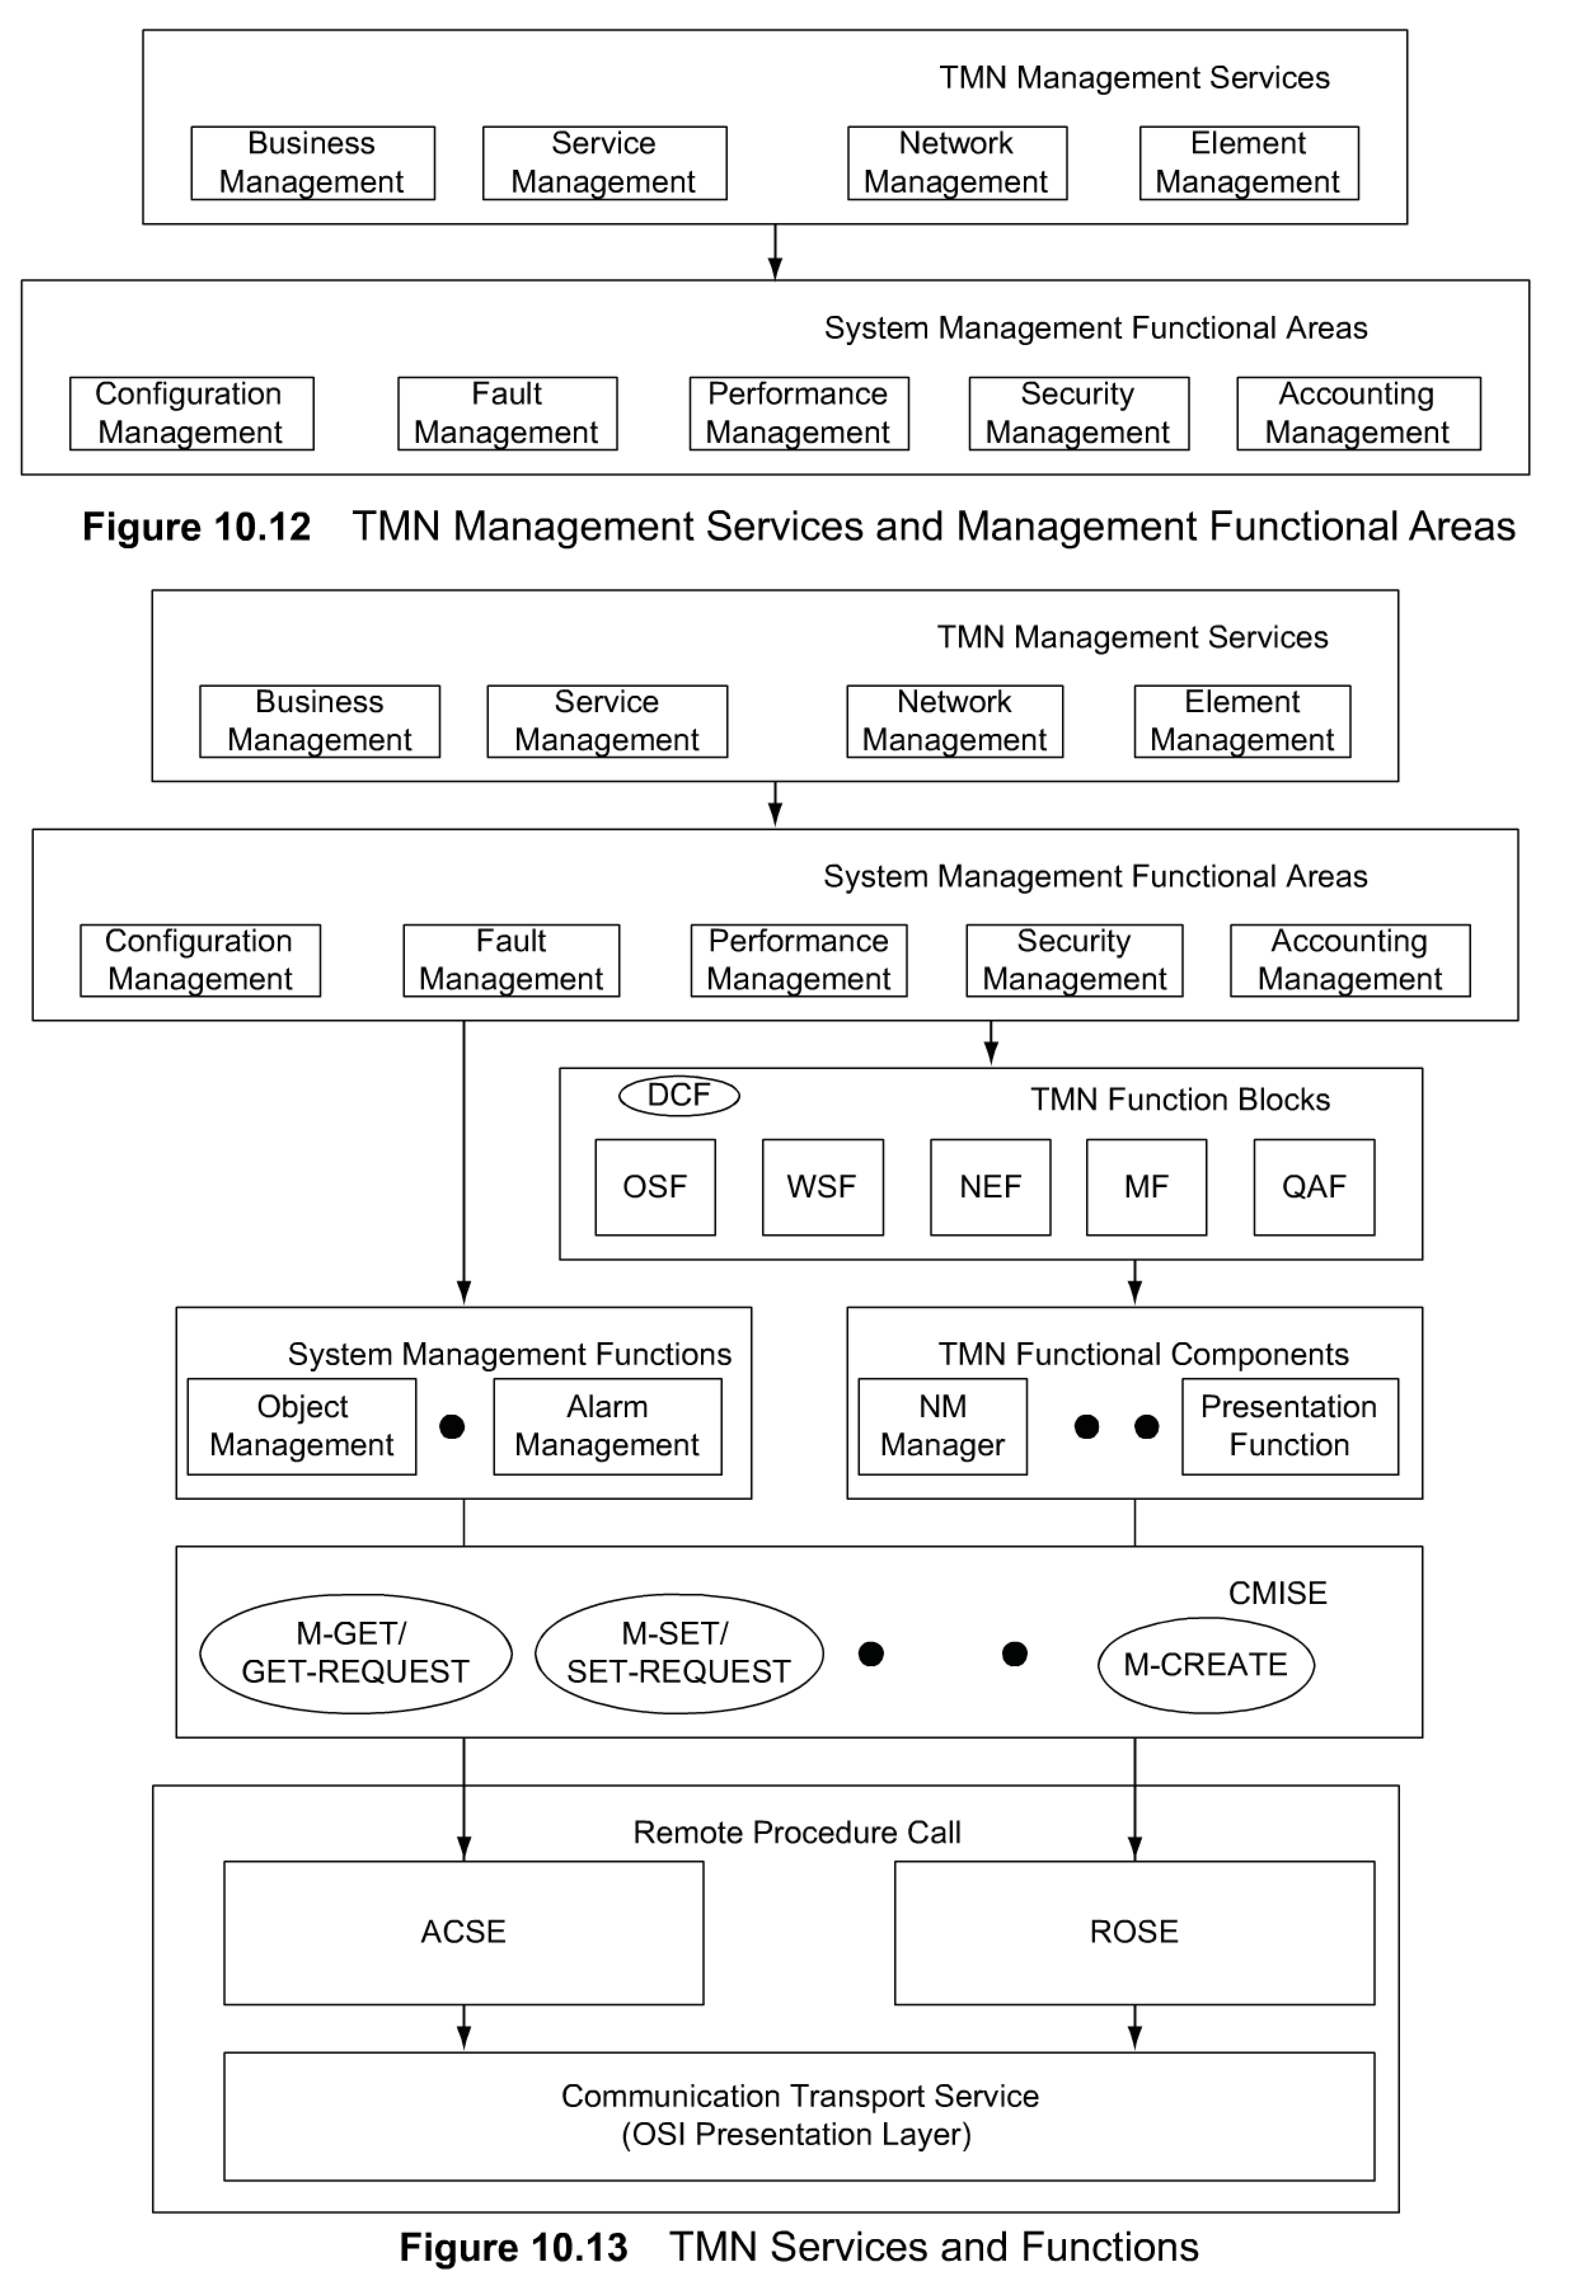
Chapter 10 Telecommunications Management Network
TMN Services & Functions
10.7 TMN INTEGRATED VIEW
let us look at the overall picture of how all these fit together.
The four TMN management services, business, service, network, and element — are at the top of the hierarchy. They invoke the system management functions.
The five components in the system functional areas are the management application functions: configuration, fault, performance, security, and accounting.
The management applications in the system functional areas perform either system management functions or TMN functions.
The TMN function blocks, OSF, WSF, NEF, MF, and QAF, constitute the TMN function blocks. The TMN function blocks are made up of TMN functional components such as network management function, MIB, etc. DCF, although not part of TMN function blocks, is included for completeness.
System management functions include functions such as object management, alarm management, etc. System management functions are discussed in Appendix A, Section A.6. In Figure 1 0. 13, we could have embedded the system management functions in TMN function blocks and TMN functional components, but have shown them separately in order to visualize them in a non-OSI environment. TMN has been exclusively associated with the OSI environment and it is only recently that it is being considered in the popular SNMP environment.
System management functions and TMN functions invoke the primitive services. Figure 1 0. 13 shows the OSI primitive services of M-GET, M-SET, etc. Equivalent SNMP services will be GET-REQUEST, SET-REQUEST, etc.
The TMN environment is a distributed environment. The applications communicate remotely with the communication transport service using RPC. In the OSI model, RPC is accomplished with ROSE and ACSE. The former does the remote operation, and the latter establishes and releases the application association. In the SNMP management model, the remote operation is accomplished using RPC and TCP/IP.

Slide 18
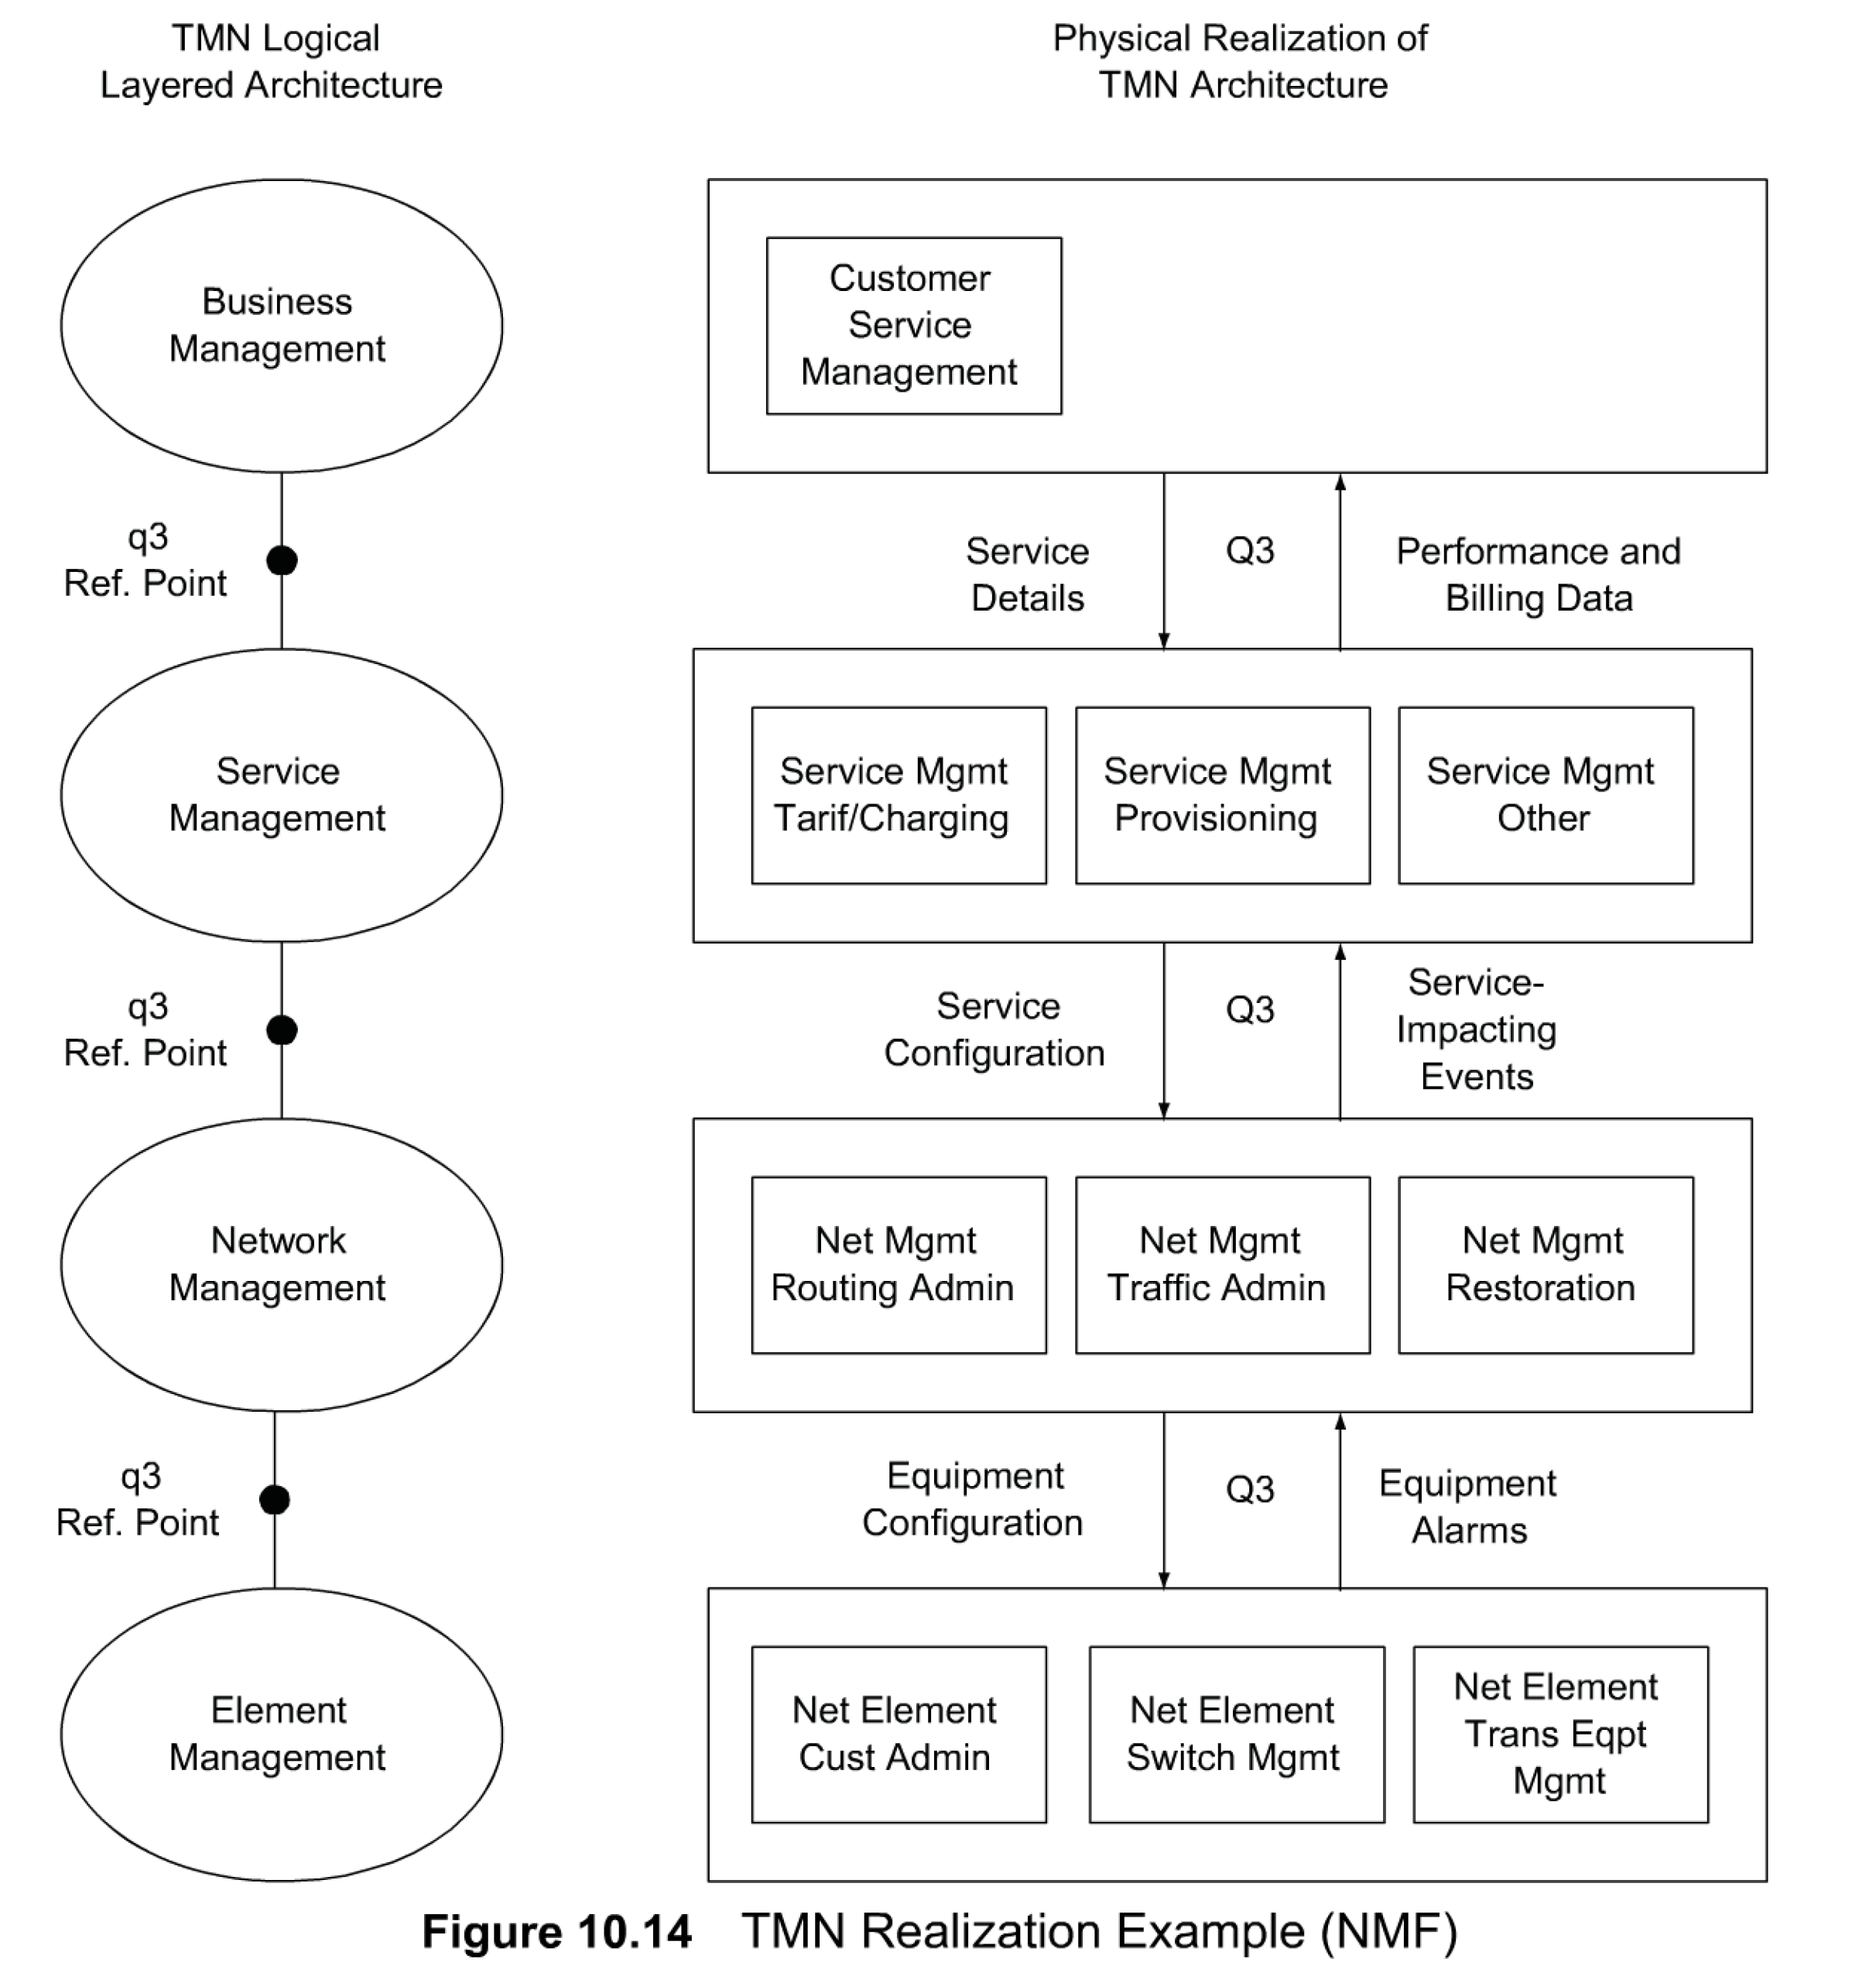
Chapter 10 Telecommunications Management Network
Example (NMF)
10.8.1 OMNIPoint
An example of the realization of TMN architecture is presented in Figure 10.14 [NMF].
The left side shows the TMN logical layered architecture and the right side a physical realization of it.
Each layer consists of several management systems providing the various services.
The layered architecture shows the TMN q3 reference points and the physical realization the corresponding Q3 interfaces.
The Network Management Forum, later referred to as NMF, is an industry-sponsored forum. NMF has developed a program called OMNIPoint, which stands for Open Management Interoperability Point.
The objective is to help companies implement management standards across a wide range of suppliers' equipment. It has developed documents [NMF] that specify mapping between the Internet and OSI standards that help TMN implementation in a hybrid management environment.

Slide 19
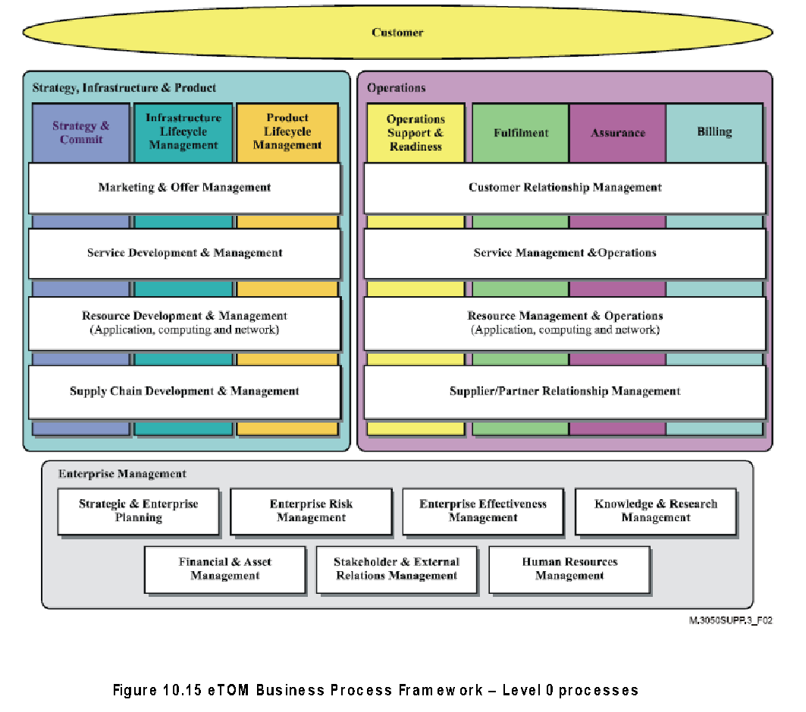
eTOM
Chapter 10 Telecommunications Management Network
The TeleManagement Forum (TM Forum) is a body whose mission is to align technology with real business, and thus is the next sequential step in the process of TMN implementation. An important goal of the TM Forum is to automate end-to-end the operations that enable delivery of "information, communication and entertainment services," and Enhanced Telecom Operations (eTOM) is the framework to accomplish this mission.
eTOM is a framework specification and provides a business process model to the telecommunications industry to define the processes end-to-end. Figure 10.15 depicts the business process architecture defined by eTOM.
The business processes are described in a layered hierarchical fashion, where process at each level can be broken down into lower-level process elements. eTOM is structured in three broad areas or Level 0 processes—Strategy, Infrastructure, and Product (SIP); Operations (OPS); and Enterprise Management (EM). Of these areas, the OPS areas of service management and operations, and resource management and operations come within the purview of network management and address a perspective similar to the functional model covered in Section 3.9. Each Level 0 process in turn contains detailed components at Level 1, 2, etc.
  Notes
TM Forum top-down implementation approach of TMN (ITU-T)
eTOM (enhanced Telecom Operations)
  Framework to automate delivery of “information, communication, and entertainment services”
  Addresses business processes end-to-end
  Multiple levels (0, 1, 2,and 3) based on details

Slide 20
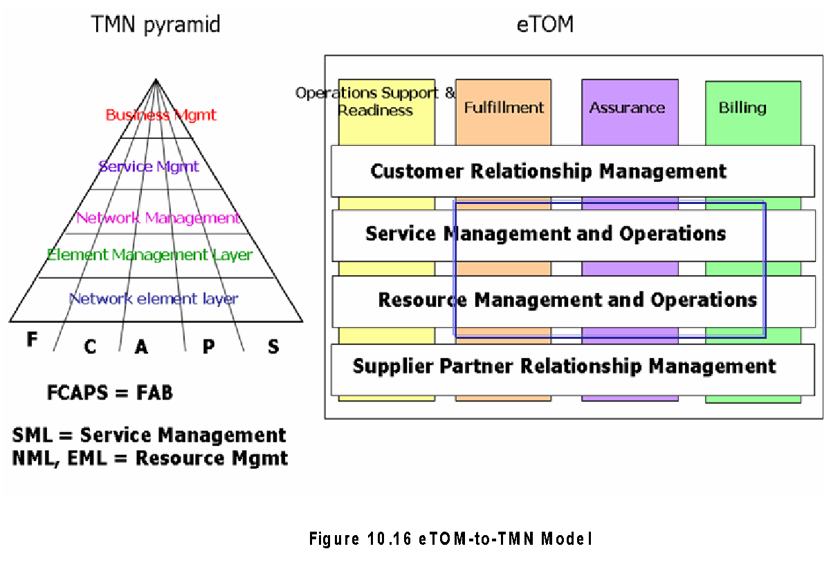
TMN & eTOM
Chapter 10 Telecommunications Management Network
The ITU-T standard adopts the management service/function approach, while the eTOM framework adopts a business process approach that builds on the management services/functions to develop a reference framework that categorizes all business activities a service provider will use.
The main difference between the TMN and eTOM approaches is that the former has been developed starting from networks and network equipment (bottom up) while eTOM is a top-down approach. The eTOM framework has been incorporated in toto within the TMN framework as a set of standards [M.3050.x],
Figure 10.16 depicts the subset of the layers of the eTOM map that are implemented as applications in a typical NMS product alongside a rough correspondence with the more traditional ITU-T-based TMN visualization. While the management functional areas in TMN are referred to as FCAPS (fault, configuration, accounting, performance, and security), they are referred to as FAB (fulfillment, assurance, billing) in eTOM.
The applications in the box of Figure 10.16 are typically implemented as part of an NMS product.
  Notes
eTOM-to-TMN mapping of functions
  Fulfillment Configuration
  Assurance Fault
  Performance
  Billing Accounting
Equivalent NMS application functions in both TMN and eTOM

Slide 21
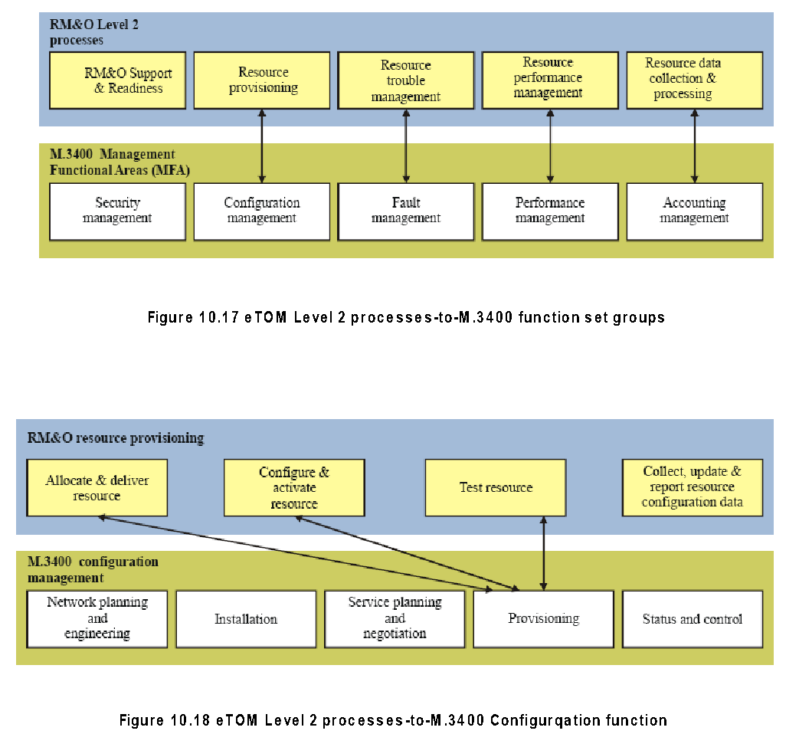
eTOM-to-TMN
M.3400 (Level 2) Processes
Chapter 10 Telecommunications Management Network
Figure 10.17 shows the Level 2 processes for the Level 1 processes of FAB activities in service management and operations, as well as resource management and operations. Each Level 2 process element is in turn broken down into finer Level 3 elements representing a greater level of detail.
The implementation of the OSI management application functions described in Section 3.9 is covered in detail by ITU-T specifications M.3400. The mapping of these functions to Level 2 eTOM processes is shown in Figure 10.17. There is a one-to-one mapping of four of the five functions, the exception being security management [M.3050 Sup 3], Figure 10.18 illustrates the mapping of the specific case of configuration function mapped to eTOM Level processes.
  Notes

